Slide 1
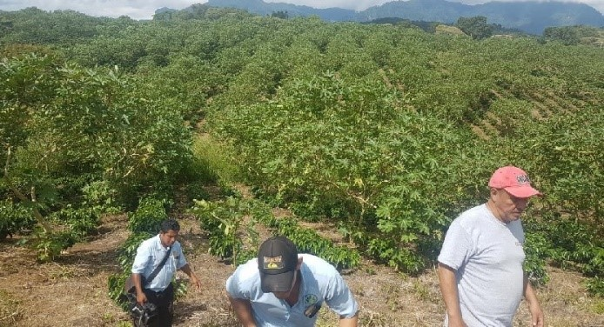
CONCEPT: INTRODUCING “A CASTOR ECONOMY” CASTOR CULTIVATION CONVERTED TO RENEWABLE ENERGY Objective: “Meeting our 2050 SDGs via transitioning to Renewables and a Bio-based Economy” A: Starting here in Italy by facilitating the European Transport Industry reach net zero emissions, either making all fossil fuel carbon neutral by mixing as an additive 14% of our Patent Derived Castor Based Biofuels or eliminating fossil fuels entirely using our non-toxic, renewable and sustainable bio-fuels as a replacement. B: Revitalizing and rejuvenating the abundant number of rural farms, towns and cities that are dilapidating by focusing on Rural Socioeconomic Revitalization Stimulation via a Renewable Bio-based Castor Economy generating up to 100-Billion Euros Annually, by producing “Renewable Energy, Bio-Based Consumable Products and Food”, based on the proven 4-Returns Scientific Approach to Landscape Restoration, Carbon Sequestration and Biodiversity Conservation. Tackling ALL 17 Sustainable Development Goals. Scope: Portugal, Spain, France, Italy & Greece. Proposed Implementations & Costing Forecasts: Example ITALY. Italy requires and consumes 2-Billion Litres (2-Million Metric tons) Diesel Per Year. Using our Protective Plant Variety WAINER/J2 (Patent Attached) this would require 833,333.33 Hectares of Castor / Land Cultivation. To achieve Carbon Neutral status by mixing 14% of our Castor Bio-diesel to fossil diesel this would require = 116,666.66 Hectares Castor Cultivation. Ways in which to achieve the above outlined objectives; Cooperative of farmers. Italy has over 1.6 million farmers / agricultural holders., average land size holding 7.9 hectares totalling 12.6 million hectares, if less than 1% participated by converting over to Castor Cultivation we would reach our first objective of 14% Bio-diesel mixed into fossil fuel and if 6.5% of Italian farmers participated we would reach our final goal of 100% Sustainable Renewable Bio-Diesel Production. Example Olive Groves: Italy has around 1,075,000 Hectares of Olive Groves (360,000 in Apulia alone), many of which are old and non-producing, here alone we have enough land ready to immediately implement our proposed project/objectives with little to no moneys needed for land preparation (eliminating the highest cost of all) – by generating just 15% cooperation in the olive industry alone, we achieve our first objective - 78% cooperation would make Italy 100% self-sustainable on green oil.
Preliminary Results: After over ten-years of research and development we created a unique Patented Protected Castor Plant Variety that is high yielding, long living, drought resistant. Using the Castor Oil obtained we have proven to produce sustainable non-toxic bio-diesel cheaper than toxic fossil diesel.
Methods Used: Standard Bio-diesel production using standard industry oil extraction and methyl ester bio-diesel conversion. Here we take you through the process of converting Castor Oil to Biodiesel https://www.youtube.com/watch?v=oa1LSWad6n0&feature=youtu.be
Each hectare of cultivated castor will produce on average around 2,400 litres’ bio- fuel per year, on burning that fuel around one (1) ton of carbon emissions will be released, on burning 2,400 litres’ regular fossil aviation fuel one emits over seven (7.5) tons carbon emissions. Each hectare of recuperated terrain using our Castor Trees, capture and sequestrate at least 21 tons Carbon per year, by introducing and burning our bio fuel derived from our Castor trees, we release only one (1) ton emissions, hence we have a carbon credit of twenty tons. By mixing 14% of our eco diesel as an additive essentially eliminates the 86% fossil fuel carbon footprint emissions. (Picture represents a 70-hectare cultivation of our mature Castor Trees at month 18 and young Coffee)

Slide 2
Practical Solutions For A Sustainable Future
Olive farms are on the decline, by introducing and combining Castor Cultivation, Olive growers can supplement/increase their incomes based on the foreseen net pricing by between 1,750.00 Euros per hectare per year to as much as over 3,500.00 Euros per hectare per year.
In Italy (& Europe/Mediterranean) it only costs around 800.00 to 1,200.00 Euros to hand pick 1 hectare and the farmer can earn between 1,750.00 to 3,500.00 per hectare per year depending on tree density and configuration, plus maintenance and land quality- it is safe to estimate an average earning of 2,625.00 with an average picking cost of 1,000.00, leaving a net profit of around 1,625.00 (additional) per hectare per year for the farmer- or the small holder can simply pick their own crop and earn an additional 2,625.00 per hectare per year (1 farmer or farm worker can facilitate between 10 to 12-hectares land per year), meaning the average small holder with 7.9-hectares could potentially earn an additional 20,737.50c per year by way of our new Castor Industry, this makes us one of the best paying cultivation industries in Europe.
We estimate for Olive Growers intercropping Castor with between 550 Trees (= 5.8-tons) to 660 Trees (= 6.9-tons) per hectare will generate @ 0.30c per kg = 1,742.40c to 2,090.88c per hectare per year additional income (each of our Proprietary Castor Trees produce on average 10.5kg Castor Seed per year, generating 3.15 Euros per year income for the farmer).
For farmers who want to mono-cultivate or maximize potential during the first 3 to 4-years of olive growing, our maximum configuration per hectare is 1,110 Castor trees at 3-meter spacing’s, this will yield around 11.7-Tons Castor seed, generating an income of around 3,510 Euros per hectare per year (later on they can reduce the amount of Castor trees to their liking).
Current International Market Price is between 0.60c to 0.66c (average of 0.63c), we offer 0.30c per kg on our Proprietary Protected Plant Variety Castor Seed because our high yielding Castor strains yield 3 to 5 times more than our patented competition EvoGene and 6 to 10 times the world average, at minimum our farmers will receive at least 3 to 5-times the equivalent they would earn by cultivating common castor and selling to market.
It is extremely important to note; we are the only one of two Castor Projects in the whole world that hold Patents, one is EvoGene ( Evogene to Establish Evofuel Ltd. for Developing Advanced Feedstock for Biofuel – Evogene ) – with their Castor Subsidiary Casterra -Casterra - Revolutionizing the Castor Oil Market – they focus on mechanized Castor Cultivation using Castor Bush varieties –
We on the other hand focus on CASTOR TREE cultivation- with us been the only company in the world with a Patent on a Castor Tree (High Yielding / Drought Resistant/ Long Living)- our business model is uniquely different and requires manual picking, same as coffee, cacao, grapes etc. good news is we yield between 6 to 10+ tons Castor seed Per Hectare Per Year- this is 3 to 5 times what our competition yield per hectare, per year.
See for yourself what we do, if you like what you see, here is your opportunity to enter this new bio based industry and invest in tomorrow’s green future.
We help the Coffee & Cacao Growers in Central America (Honduras & Nicaragua) generate an income during the first 3 to 5-years and beyond, as Coffee & Cacao same as Olive do not derive a viable crop and income during the initial years- plus the nutrients obtained from the Castor foliage secure a healthy yield for the farmer’s primary crops.
Olive groves have sufficient spacing’s to accommodate our Castor trees, Olive picking only requires a few months a year – here Castor allows for all year picking = all year job retention = all year financial income.
The Olive Industry & Olive Trees are facing threats like Xylella Fastidiosa that kill the trees, by placing Castor Cake /Ricin at the base of the trees will combat this, together with spraying the trees with Cold Pressed Castor Oil (mixed with wood alcohol as a diluent). We are the only ones in the world who have experimented in this manner, killing plant bacteria's and funguses by way of Ricin during the past 10-years various trials.
(Additional possible intercropping options are Grape: Italy has over 651,000 Hectares Grape Cultivation; Citrus Trees: Italy has close to 188,000 Hectares Citrus trees? or Nuts as Italy has 186,000 Hectares available? Smaller industries like Avocado with 20,000 hectares or Banana & Mango that are on the rise due to an increase in warmer weather/climate change etc. can also participate in our initiative: as see in this video example: Practical Solutions For A Sustainable Future (youtube.com)

Slide 3
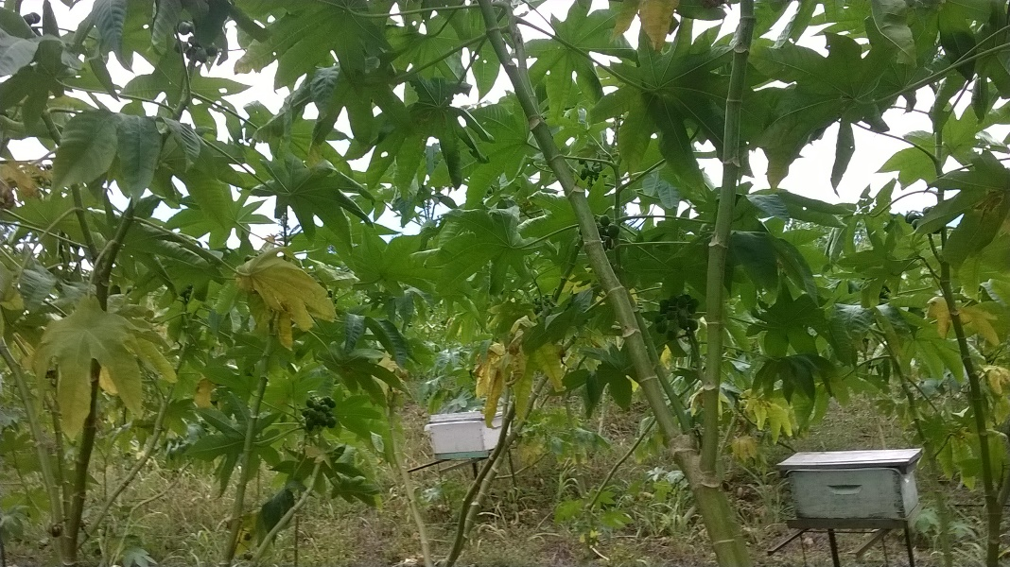
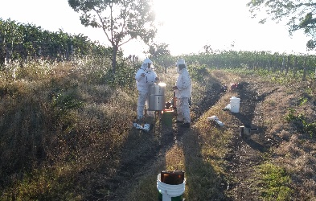
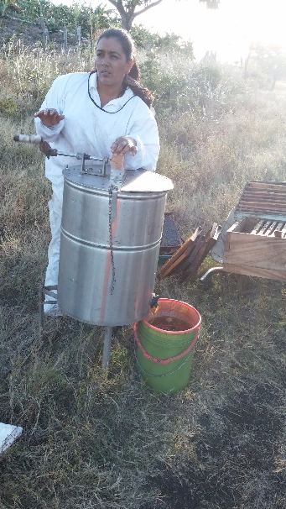
Practical Solutions For A Sustainable Future
We too use bees as part of our project to improve pollination/production, our Patented Castor trees flower all year-hence we have honey production all year = additional income & job creation + biodiversity protection + bees improve productivity and income that is also extended to the farmer’s (or his neighbours) other crops.
We offer the farmer 10% of the income derived from the honey yield and sale. We have our own crews and processing facility, all we require is that the farmer allow us access (by-weekly or monthly or as deemed necessary), the farmer can sustain between 4 to 10-bee hives per hectare depending on the condition and density of the Castor cultivation, this will give him (also depending on the sale price of the honey) roughly between minimum 200.00 to 500.00 Euros per year, per hectare, should they join or qualify for our Bee Initiative.
By intercropping Castor with the above cultivations, not only maximizes our land and human resources potential, farmers can now make additional income improving their families and their communities lives.
Spain, Portugal, France, & Greece all hold similar or greater potential – Using our Protective Plant Varieties, statistics show that the combined 5-Medeterenain countries can sufficiently produce all of Europe’s Oil and Energy needs in a renewable, sustainable, ecological fashion, meeting our 2050 Net Zero objective way before 2050.
In theory because our Castor trees reach maturity in under 18-months, with a combined national level endorsement by government and full cooperation from the farming industry one can reach our proposed objective in as little as 3-years.
Our project facilitates the revitalization and resuscitation of small and medium farms, rural towns and cities. Providing permanent jobs based on sustainable regenerative agriculture focused on a Castor Bio-Based economy producing renewable non-toxic green biofuels and consumer (800+) products.
Every 10 to 12 hectares provides 1-permanent agricultural picking job based on an eight-hour day (x5) = 40-hours per week, @ 6-euros per hour basic wage x a 22 work days per month, generating 1,056.00 Euros per month (manual labour) the hourly rate of 6.00 euros could increase to 8.00 euros as it is related to weight and productivity, hence it is possible to earn as much as 1,408.00 + Euros per month should the worker outperform expectations.(Italy has no minimum wage law, the average salary in Italy is around 960.00 Euros per month, here we create opportunity and fare wage, by assisting us in achieving our objective we will not only make the Italian farmer wealthy we too will make our country strong and self-sufficient/independent once more)
For every 1-agricultural Job, by making or converting the Castor Oil into bio-based products such as bio-pharmaceuticals, bio-plastics, bio-paints etc. 1-Factory or Industry Job is created (@8-euros per hour = 1,408 Euros monthly income). Each worker can pick on average 45kg per hour dry castor cones (67% Seed / 33% Shell /Husk), multiplied by 8-hours will effectively give us 118.8 litres Castor Oil per day (Example: converted to hand soap bars equates to 2,360 bars of soap per day, based on an 8-hour work day = 1-bar of soap every 5-seconds needs to be produced, packaged and shipped-with the help of machinery – using less machinery and more manpower will create up to three times as many jobs, this is something Italy desperately needs, this all begins with the farmer).
Our final objective of 833,333 Hectares creates 69,000 to 83,000 Agricultural Jobs Generating around 1.5-Billion euros in agriculture and an additional 69,000 to 83,000 Industry Jobs. Generating around an additional minimum 1 –Billion Euros in Industry Per Year.
Italy has over 1,620 small towns and cities facing extinction – by reviving just 10% of these rural towns with an average of 5,140-hectares Castor Cultivation per town would achieve our objective to make ITALY 100% Fossil Fuel Free – Farmers participating and joining our cooperative have a chance to not only revive their lives but they can revive their towns and communities too.
By reviving just 10% of these rural towns with an average of 720-hectares Castor Cultivation per town would achieve our objective to make ITALY 14% Fossil Fuel Free $ 100% Carbon Neutral Transport.
Our first objective of 116,666 Hectares creates 13,000 to 16,000 Agricultural Jobs + 13,000 to 16,000 Industry Jobs. Generating around 238-Million euros in Agriculture and an additional 158 –Million Euros in Industry Per Year = Additional 396-million Euros injected into our local economy per year.

Slide 4
Cost of Castor Oil conversion and Bio-Diesel Production (Please see Excel P&L Sheet Attached);
Cooperative of farmers
We have made sure to create a price structure that allows us to pay our farmers the majority of every Euro on every liter Castor Oil or Bio-Diesel produced and sold. We aim to compete with and mix with fossil fuel, hence we aim to wholesale at between 1.60c to 1.70c per liter and retail at around 1.70c to 1.80c per liter “Bio-Eco Diesel” or sell our Castor Oil at or around market price currently at around 1.50c per liter.
For every liter produced our farmers earn the equivalent of roughly between 0.79c to 0.84c, (based on target incentivizes) thus giving the farmer the majority lions share, as we believe in treating farmers with the respect and appreciation they deserve. Our project aims to empower our cooperative of farmers by uniting and culminating our strengths we will be able to compete and commodore industries and retain our independence and ensure our longevity and pivotal role in society as has been done for thousands of years since our hunter gatherer ancestors showed us the way to creating civilizations.
Civilizations depend on farmers for survival, farmers need to maximize their potentials and the best way to do so is by generating additional incomes on their land as to never be at the behest and mercy of the open market that relies on their labor to generate a living at the expense of the farmer’s hard work.
Independence is gained through financial independence, by having multiple crops generating multiple incomes a farmer will always be in a position of strength and will be able to fetch a fair price when dealing with the open market.
Our project does not rely on the open market, by having intellectual property that outperforms the rest, by having the skills and experience necessary, by having the infrastructure and technology at our disposal, by having abundant land and labor and by having a partnership that is not reliant on outside influences and that bypasses the middle man / traders, we are able to offer the public a finished product that is superior to our fossil fuel counterpart and that was made locally here in Italy by Italians for Italians.
Europe has vowed to eliminate the use of fossil fuels and its derivatives by changing over to a circular bio economy, where Bio-based industries replace non-renewable fossil resources with renewable bio-based products and materials from waste and biomass to produce industrial and consumer goods. This way by joining our cooperative we together will help Europe become the world’s first climate-neutral continent, while increasing the sustainability and circularity of production and consumption systems.
Castor Cultivation will play a major role in this transition as Castor Oil is the only vegetable oil that can not only make everything fossil fuel can but is used in more than 800 products and applications. For this reason alone Italian companies the likes of ENI www.eni.com are investing heavily in Castor cultivations, they on the other hand do not own “The World’s Highest Yielding Proprietary Castor Strains” (as we do) and look to produce outside of Europe using cheap labor to maximize their profits (buy low – sell high), specifically Africa with Castor operations in 9-African countries – New strategies to decarbonize transport (eni.com) & Seeds for a new energy, from Italy to Africa (eni.com) – This is exactly our objective, we started before ENI as seen in our Central American operations- they are trying to copy our business model but will fail because they cultivate bush, of which the yields are very low, they pay market price, we on the other hand are not connected to market and yield 6 to 10-times more per hectare per year, hence we outperform in many an aspect.
Italian Olive Growers can join together with our organization and its Directors to compete for our Italian Market that requires sustainable fuel made from Castor cultivation, who better than an Italian to keep Italy strong by producing locally keeping the close to 4-BILLION Euros that is spent annually here in Italy that normally goes to OPEC countries or as ENI aim to pass that on to Africa and not allow the Italian farmer to participate in an industry and future that is rightfully his, by joining forces with us, we together will stake claim as Italy is mother and home and her farmers are her children.
By producing locally, a better, cheaper more sustainable fuel, as our Castor absorbs way more Carbon Sequestration per hectare that that on a regular Castor bush cultivation, we are Castor Trees – hence it only requires mixing 14% of our Castor Bio-Diesel with Fossil fuel to neutralized the carbon footprint, ENI would have to mix more than 50% of their Castor bio-diesel to make the same claim, so we have a huge advantage over our competition from outside Italy (Africa), not only do we pay our farmers more than any other Castor farmer in the world, we are able to undercut the market price because we are not connected to the market or reliant on raw materials purchased based on open trading.
Most of all we will rather than sell to the refinery at a low cost, make the product ourselves seen as it is a very basic production process and module-system factory using state of the art new technologies that are accessible, affordable, compact and revolutionary.
We focus on a basic necessity, a product that without it the world would stand still, our product is the highest demanded product, we make a better product, we sell that product cheaper than our competition and hence we dominate that industry, this is what you would be participating in if you were to become one of our working partnerships.

Slide 5
AIM: to start operations in the state / municipality of Apulia, representing 360,000 hectares of Olive plantations (33% of Italy’s total olive production), it is estimate at around 8,000 new hectares of Olive cultivation is implemented annually.
We wish to erect micro bio-diesel and bio-gas compact refineries in each small town or nearest collective hub (advantages of micro refineries include glycerin revenue, job creation + closer to market = lower carbon footprint & lower retail price etc.).
Only if extremely necessary or in our interests such as rapid ramping up on production to meet rapid growth in the National cultivation sector, we could integrate a combination of besides producing ourselves as much as possible but if necessary sell any excess by either supplying the ENI Refinery in Sicily (seen as they currently can’t meet targets and are behind on obligations to KLM, Schiphol Airport- so far their African operations have yet to return sufficient yields) or other European Oil Refineries. - We believe this option is not necessary and will avoid by way of re-investing profits to meet production demands and because our modular system is easy to increase production because it does not entail any modifications for expansion, it’s as easy as Lego, we can double, triple or even quadruple production capacity annually- hence our business model is scalable.
We have the ability to in future not only to supply KLM, Schiphol Airport with HVO Aviation Fuel but can supply all European Airlines and Airports with our Carbon Negative HVO A1 Jet Fuel.
In our initial business plan and costings herein we aim to produce bio-gas and bio-gasoline from our waste assisting these energy sectors and creating additional jobs and revenue.
Previous Pilot Test in Nicaragua & Honduras showed to confirm viability and feasibility of concept with cooperation of over 700 farmers participating in initial R&D trials. ECOPOWER INITIATIVE – Rainforest Reliance (rainforest-reliance.org)
Conclusion: European Castor Biodiesel Production can replace fossil fuels entirely or at least by replacing 14% with our castor based eco-diesel as an additive one would eliminate the carbon footprint of the 86% fossil fuel making the European Transport Industry Carbon Neutral.
Additional Benefits & Afterthoughts; All moneys Italy currently spends annually on the importation of diesel (4-Billion Euros +) purchasing Diesel from OPEC countries (20% of the world’s oil comes from Iran alone) that use those benefits against us, will remain in Italy and go towards benefiting the Italian Population Christian and other - thus limiting foreign dependency and improving National and International Security.
In the event of a world war (currently on the thresholds) our above proposed plan may be the only feasible and viable option available and one that can be implemented in a relatively short time frame. Interesting facts; during WW1 the USA ran a successful Castor Campaign that spilt over into WW2, USA Castor cultivation was replaced entirely with fossil fuel from 1952. Today it is no longer viable or feasible to rely on cheap fossil pollutant, the time to reintroduce a Castor Economy is now.
Charles Wakefield the founder of Castrol Motor Oil in 1896 was the father of a “Castor Economy”, we are here to resurrect his (and Rudolf Diesel´s the creator of the Diesel Motor in 1900) dream of a clean, green, non-toxic, sustainable Castor Economy powered by the Diesel Motor ( 84% of the world’s energy rely on fossil fuel and gas, 97% of the world’s global transportation today still rely on fossil fuel, with the majority relying on the Diesel Motor GREEN OIL = RENEWABLES – Rainforest Reliance (rainforest-reliance.org)).

Slide 6
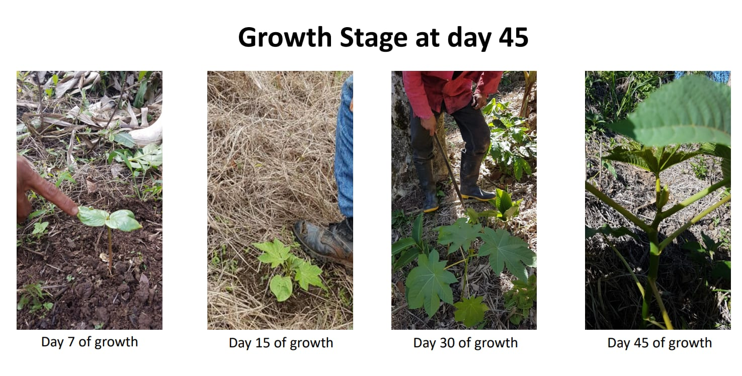
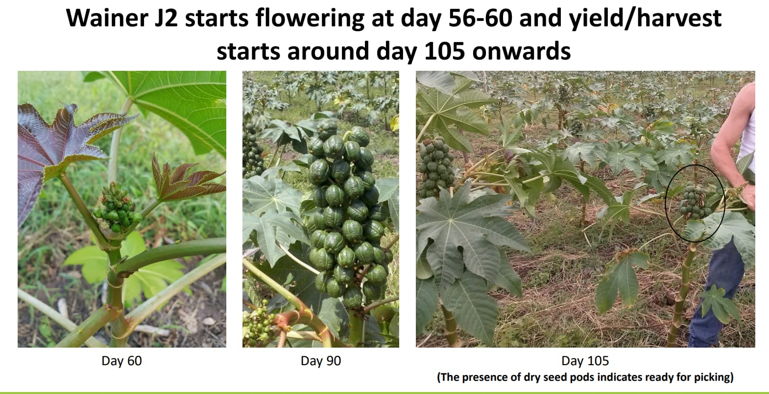
Protective Plant Variety WAINER/J2
Because our Proprietary High Yielding, Long Living, Drought Resistant Patented Castor Strain/s are not related to the open market or public, we hold an advantage as our Oil Prices (Energy Cost) are done on a fixed exclusive contractual basis allowing for economic and political stability, combating market fluctuations and inflation. In Central America we work on a 15-year fixed contractual price with our cooperative of farmers, with the price increasing slightly every 5-years.
Here in Italy we would like to work on the same basis, however it is not imperative as we will implement an open door policy that allows for participation on a 3-year minimum basis with our price fixed to all members and we will not increase our pricing until 2029/2030, anyone joining in this timeframe will be subject to the standard price fixed offering. Our price in Central America is 0.17c per kg, equivalent to 1,100.00 per hectare, here we offer our Italian farmers 0.30c per kg, nearly double - Italian Quality = Italian Made.
(It is estimated ENI Africa pay their farmers less than 900 per hectare if they pay fair market price based on their presumed average yields of 1.5-tons to maximum 2-tons Castor seed per hectare per year (World Average is 1-Ton Per Hectare, Per Year), or even possibly less than 600.00 per hectare, should they look to acquire below market seen as they are investing in Africa one would presume so?) This explains why ENI are in Africa, it’s essentially twice to three times cheaper to produce in Africa, but yet we still by paying our Italian Farmers Fair Wage can undercut at retail ENI or any other competition, thanks to our proprietary intellectual property in the form of a seed, plant it and watch it grow.
Castor Oil is vital in the advances in medicine and technology, used in 100s of applications and components/products in these two industries alone, most recent advances are bio-plastics, castor Bio-degradable plastic is up to 13 times stronger than fossil plastics. By mixing 61% Castor Bio- Plastics with 39% Fossil plastics it retains its bio-degradable characteristics, hence it is possible to eliminate our fossil plastic footprint by recycling and redistributing, should the new-plastics combination end up in the ocean they disintegrate and become fish or plankton food and if in a landfill they become/act as compost/fertilizer.
We are currently working with many Universities (one of which is Politecnico Di Torino, Italy, David Chiaramonti Energy Department), plus we are currently in collaboration with Universities in Istanbul, Turkey & Bengal, India in relation to using Castor Oil & Ricin Extract and Castor Honey & Propolis as an Anti-Cancer Remedy, currently exploring Castors medicinal properties and capabilities.
Our Roadmap
PHASE 1: SEED
Our Primary objective is to cultivate a minimum pilot of 1,000 to 1,500 hectares Castor Cultivation together with existing and new Olive Orchards and together erect a factory that will press Castor Oil along with converting that oil into non-toxic biodiesel and bio-gasoline to be used to generate clean, green renewable combustibles = energy.

Slide 7
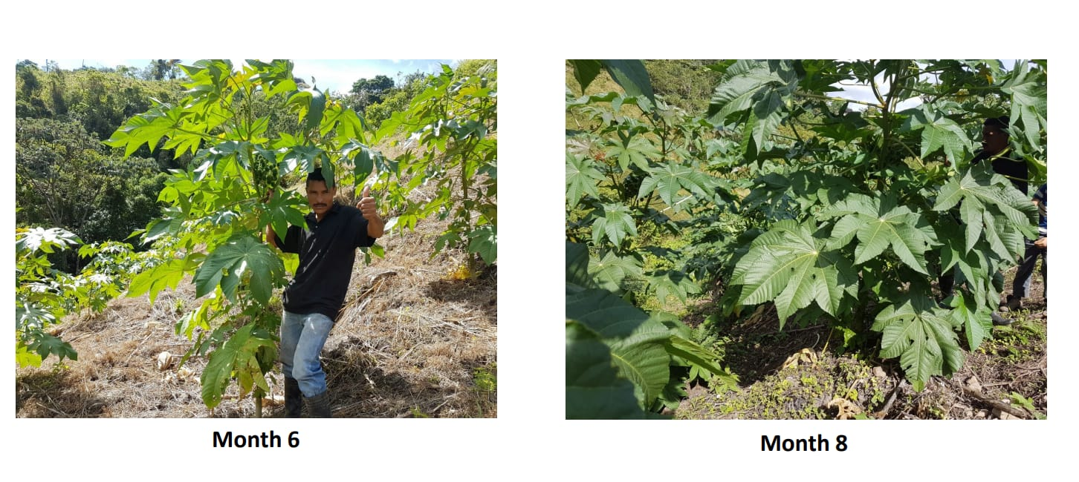

Slide 8
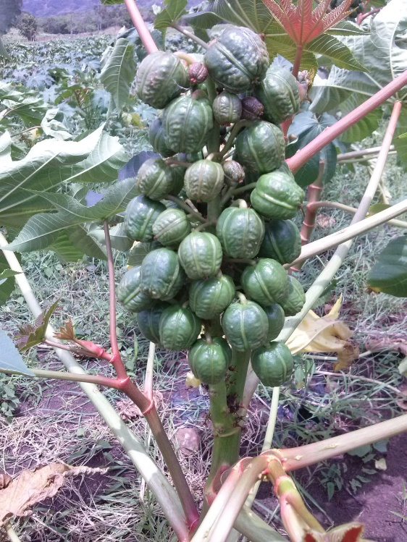
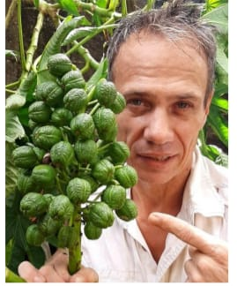
Wainer J2 Castor Strain
Month | Yield (in grams) |  |  | Average (in grams) | Average (in LBS)
1 | n/a | ~ | n/a | n/a | 0
2 | n/a | ~ | n/a | n/a | 0
3 | n/a | ~ | n/a | n/a | 0
4 | 40 | ~ | 60 | 50 | 0.11
5 | 60 | ~ | 80 | 70 | 0.15
6 | 80 | ~ | 100 | 90 | 0.20
7 | 100 | ~ | 120 | 110 | 0.24
8 | 120 | ~ | 140 | 130 | 0.29
9 | 140 | ~ | 160 | 150 | 0.33
10 | 160 | ~ | 180 | 170 | 0.37
11 | 180 | ~ | 200 | 190 | 0.42
12 | 200 | ~ | 240 | 220 | 0.49
13 | 240 | ~ | 300 | 270 | 0.60
14 | 300 | ~ | 375 | 337 | 0.74
15 | 375 | ~ | 468 | 421 | 0.93
16 | 468 | ~ | 585 | 526 | 1.16
17 | 585 | ~ | 732 | 658 | 1.45
18 | 732 | ~ | 880.1 | 806 | 1.80
Growth Analysis Chart for Castor Strain Wainer/J2
Evaluation month 1 through month 18 (until maturity)
This chart shows the growth phase for the strain Wainer/J2 until maturity at age 18 months, thereafter the plant will live for up to 5 to 7- years, we replant our castor every 5 years, with the castor trunks once dead we convert to rope and paper carton.
From 18 months through to month 60 the Castor Tree WAINER/J2 will remain constant at around 800g per tree, per month.
In mono-cultivation our optimum spacing per tree is 3-meteres by 3-meters = 1,110 trees per hectare. When intercropping with other food crops such as Cacao or Olive we generally plant 4 meters apart, this equates to 660 trees per hectare.
Each tree in essence earns the farmer 3.15 euros per year based on our pricing.
FROM THE MOMENT WE COMMERCIALIZE OUR SEEDS HERE IN ITALY, WE HAVE ONE-YEAR TO REGISTER, FROM THAT MOMENT ONWARDS WE GET 20-YEARS PROTECTION FROM DATE.

Slide 9
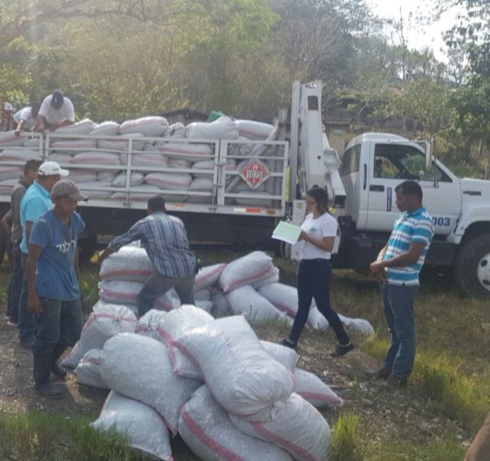
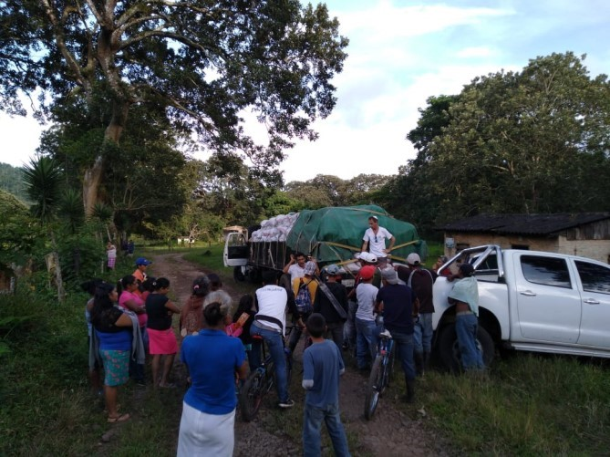
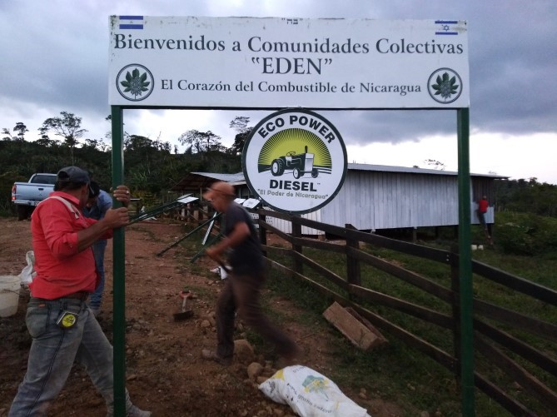
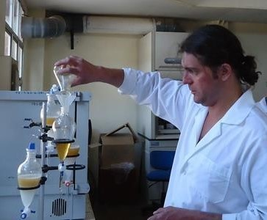
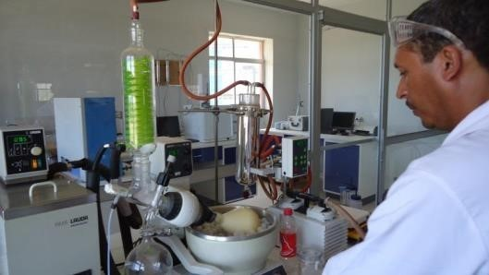
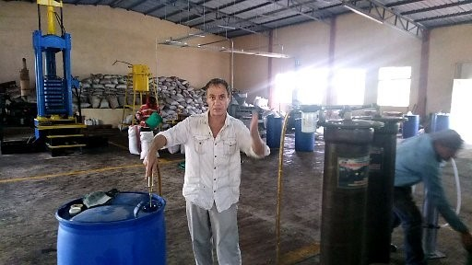
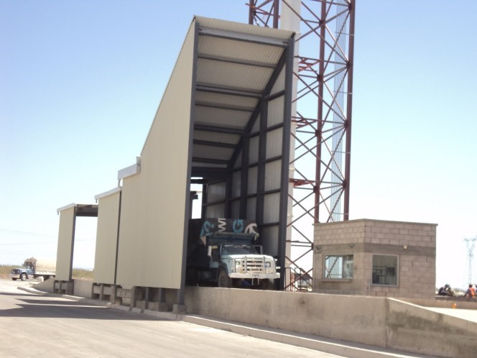
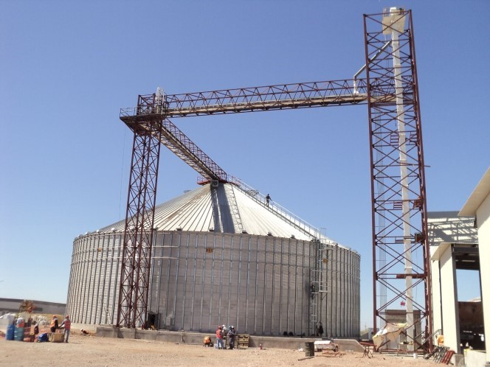
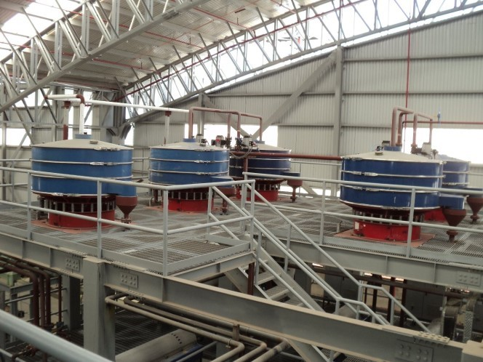
VISUAL PROJECTION OF YOUR NEW INDUSTRY
PHASE 2: PRODUCTION

Slide 10
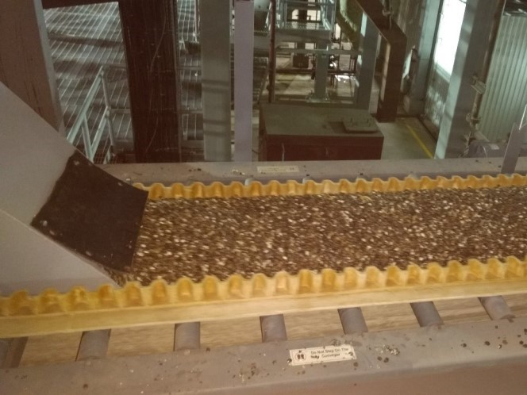
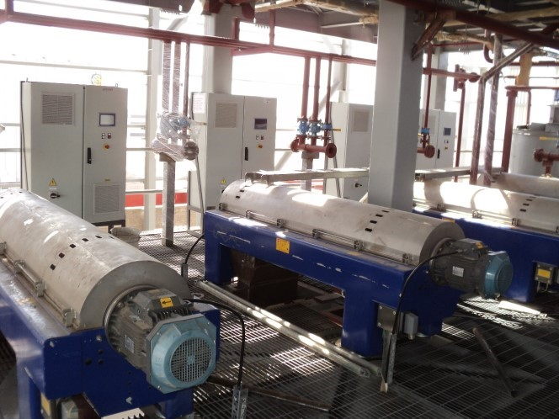
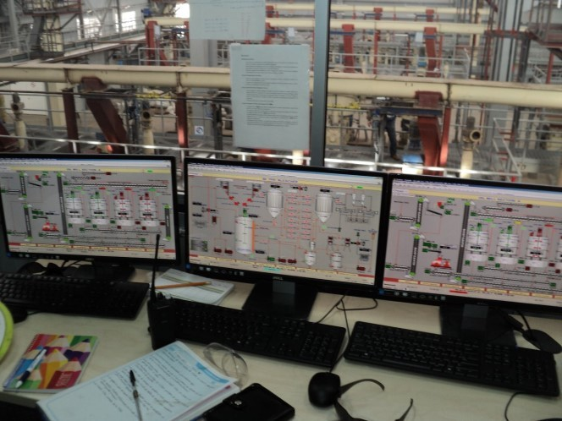
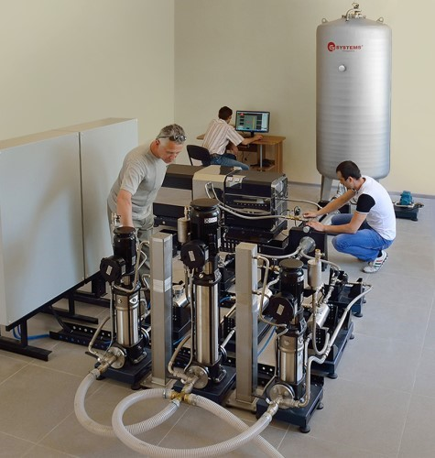
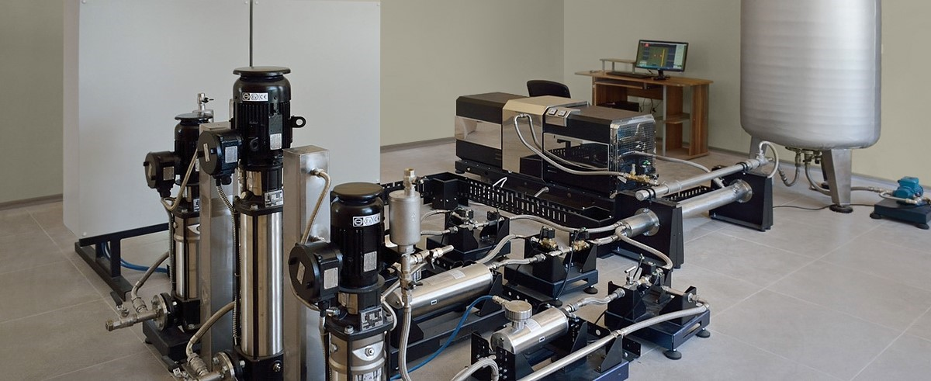
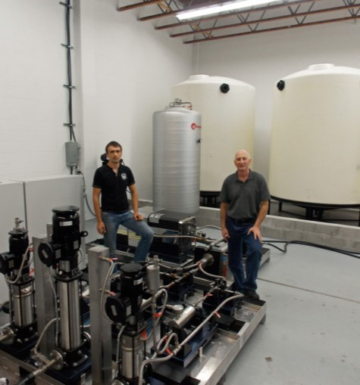
STATE OF THE ART UKRAINIAN TECHNOLOGY FOR BIO-DIESEL PRODUCTION. HERE WE CAN PRODUCE UP TO 16,000 LITERS PER HOUR WITH A SIMPLE MODULAR DESIGN THAT ALLOWS US TO FACILITATE MICRO INDUSTRY IN RURAL ZONES, EACH 35,000 HECTARES WILL REQUIRE ONE FACTORY LINE AT FULL CAPACITY THAT WILL PRODUCE OVER 100 MILLION LITERS PER YEAR.

Slide 11
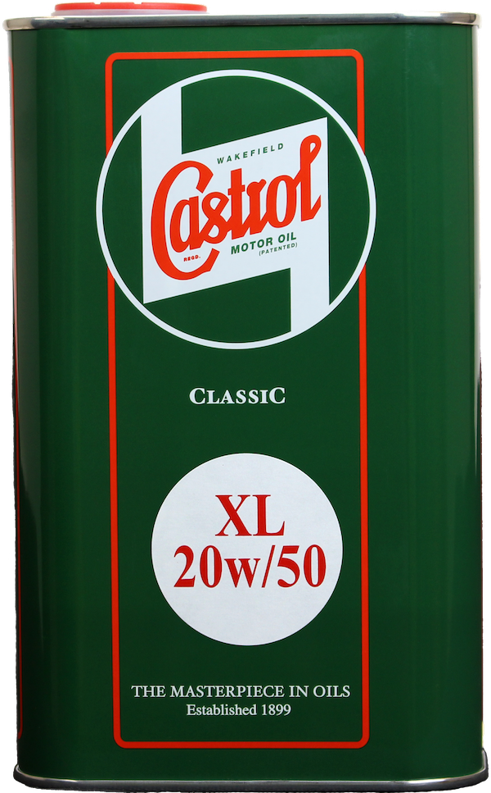
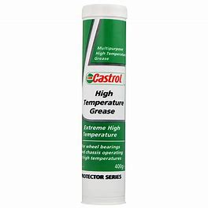
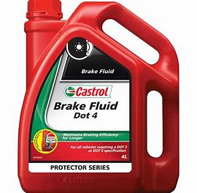
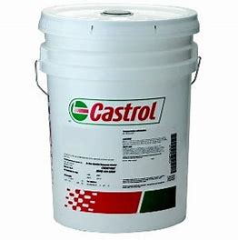
IMPLIMENTATION ON CHANGING FROM FOSSIL TO RENEWABLES HERE WE HAVE A CHART THAT SHOWS THE TIME FRAME IN RELATION TO PRODUCTION, IN 3 YEARS ONE CAN FULLY IMPLIMENT A 100% TRANSFORMATION FROM FOSSIL FUEL TO RENEWABLE NON TOXIC DIESEL
100.0
%
64.4
Besides Bio-Fuels we intend to produce packaging, break fluids, motor oil, industrial soaps and household soaps together with pharmaceuticals production lines / factories.
We are able to make break fluids by simply heating up our degummed and cleaned castor oil to over one-hundred degrees (boiling point) and then the composition changes to a blown oil, this is what we all know as brake/hydraulic fluid.
We too are able to make motor and industry grease by simply mixing up our cleaned castor oil with an emulsifier (calcium stearate, sodium stearate, lithium stearate, as well as mixtures of these components.)and then the composition changes to what we all know as motor or industry grease.
%
39.8
%
13.6
%
6.8
%
Mth 06
Mth 12
Mth 18
Mth 24
Mth 36
CASTROL (GTX) MOTOR OIL COMPANY C-A-S-T-O-R O-I-L “take out the O and the I = CASTROL

Slide 12
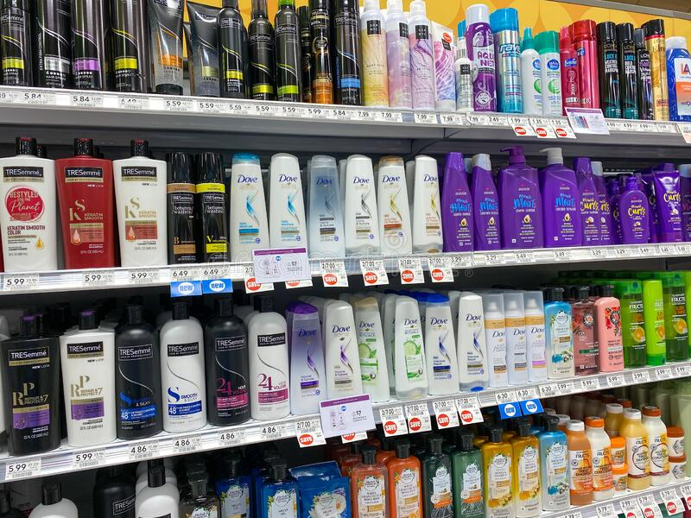
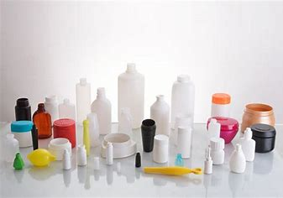
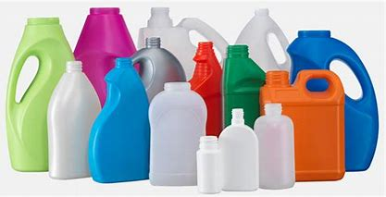
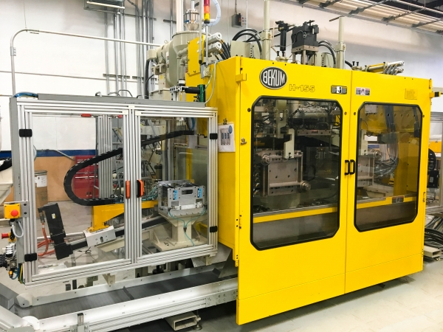
ADDITIONAL FACTORY TO BE IMPLEMENTED IN ITALY (Pharmaceuticals)
Servicing local Italian and European demand for affordable non-toxic every day household hygienic items.
Starting with:
Soaps (solid and liquid) for bathing and household
Shampoo and Conditioners
Laundry Detergents (solid and liquid)
Deodorants
Creams
Glycerin amounts to 20% of by-product derived from the conversion of Castor Oil to Bio-Diesel.
Glycerin is a highly sort after product used in many an industry from pharmaceuticals to automotive, amongst many things glycerin is even used as a base for chicken feed, 1kg glycerin has the same protein as 2kg corn or soy meal and is often used as a supplement.
We estimate around 600,000 kg glycerin per year, per 1,000 hectares Castor cultivation. Current market price is between 4.00 to 7.00 euros per kg.
We too have the option to use our glycerin as a base to make many finished consumer products or industry products.
Expansion of Castor Oil Hydrogenation Conversion to be implemented later converting liquid castor oil into a solid form to be used in the food industry such as peanut butter, chocolate, margarines etc. as a binding agent and also in the pharmaceutical industries
ADDITIONAL FACTORYTO BE IMPLEMENTED IN OUR INDUSTRIAL CITY
Packaging and Blow Injection
We will look to make all our retail packaging on site by at first melting plastic pellets into blow injection molding.
In future we intend changing over from pollutant plastic pellets to our own Castor polymer’s.
We will need to initially concentrate on producing packaging that is relevant to our consumer product lines.

Slide 13
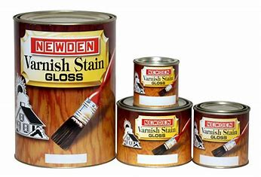
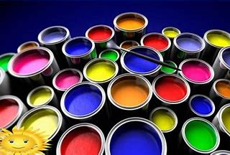
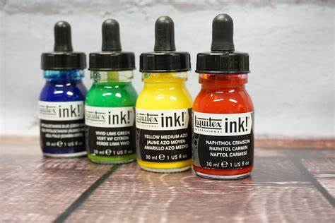
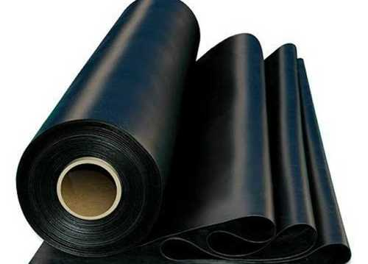
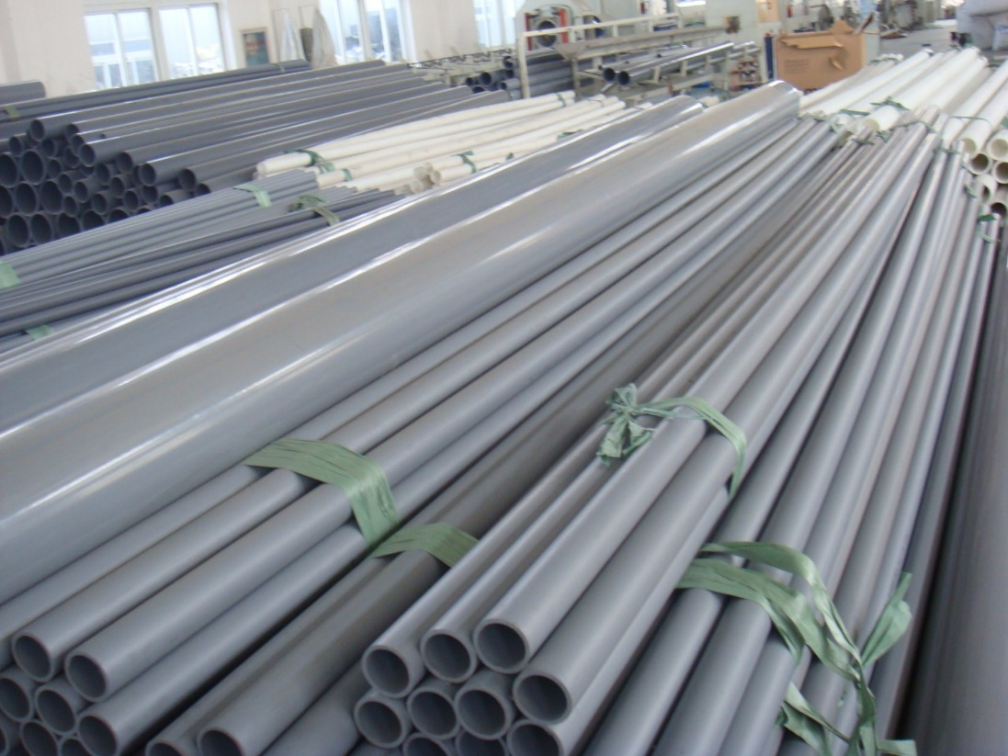
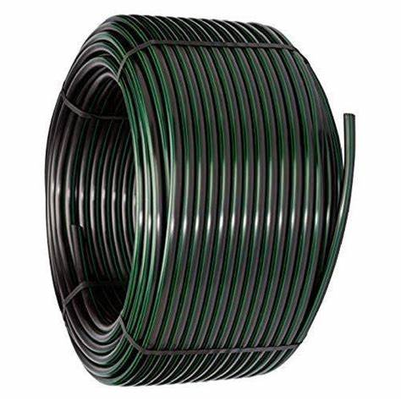
ADDITIONAL POTENTIAL FUTURE FACTORY
Ink, Paints, Varnishes and Rubbers
Castor Oil and its derivatives have a wide spectrum of uses in Ink, Paint, Vanish & Rubber industries.
Let us look at some important Castor Oil derivatives in the following industries.
Dehydrated Castor Oil (DCO) is used as a primary binder for paints, enamels, sealants, inks and more. It has functional use for the production of alkyd resins, acrylic and epoxy ester resins for the paint industry, coatings and as an additive in ink formulations.
Paints which integrate this oil grade are super white and delivers a superior finish. DCO is used with phenolic to obtain fast dry coatings with maximum alkali resistance as required in sanitary can linings, corrosion, resistant coatings, high-performance traffic paints, varnishes, vehicles, wire enamels, aluminum paints, appliance finishes and marine finishes, etc.
Blown Castor Oil is a derivative with higher viscosity. Also known as oxidized oil, Blown Castor Oil is used in hydraulic fluids and as a lubricity additive in the manufacturing of lithographic inks.
Blown Castor Oil has been a classic plasticizer of shellac rosin, natural and synthetic resins, celluloses, and natural & synthetic rubbers.
Refined Castor Oil is used as a substantially insoluble and infusible polymer. As a lubricant it is used in petroleum emulsification- hydraulic and brake fluid, polish, inks, paints, rubbers, etc. It is used in combination with styrene and di-isocyanates for film-forming.

Slide 14
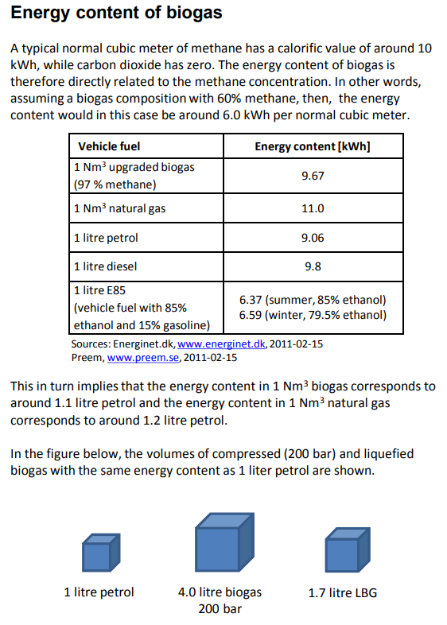
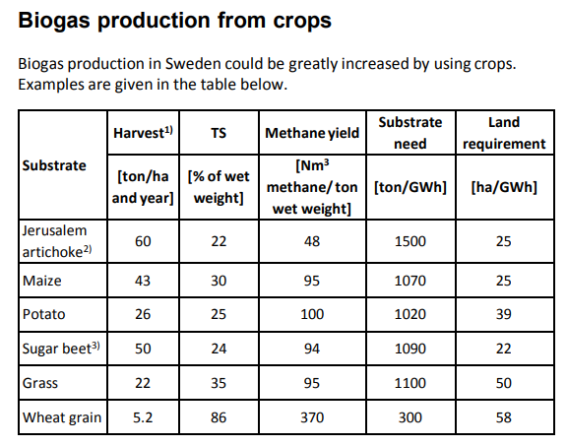
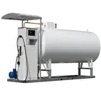
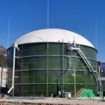
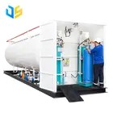
Bio-Gas Production from Castor Waste
We use bio-waste (outer shells and biomass, including Castor Cake = waste after Oil Pressing Castor Seeds) to produce Bio-Gas used in domestic heating and cooking.
Each hectare of Castor cultivation produces on average at least six-tones (6T) of Castor seed per year, of which 56% is biomass waste (= 3.3T waste), plus an additional three-tons (3T) biomass from Castor Shell, to total around 6.3T biomass residual per hectare per year.
Each ton of Castor or grain residual can produce between 18% to 22% Biogas with an average of 20% per ton.
6.3T x 20% = 1.26T Bio-Gas per hectare per year.
Current retail cost is around 1.10c per kg gas.
Each hectare can produce the equivalent of around 1.380.00 retail price. It is safe to say that each hectare can generate at least 500.00 to 800.00 euros’ additional income per year (depending on our discounted sale / retail price), the cooperative of farmers all share in a10% pool profit share system.
The energy derived can also power our industrial city.
Castor Waste @ 6.3 to 9.6 ton/ha, Methane ton wet weight @ 20% = 1,260 to 1,920 kg per ha per year @ 1800 GWH per ton = 20ha to 30ha per GWH

Slide 15
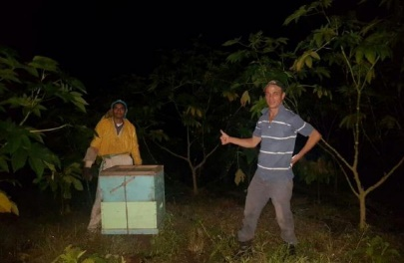
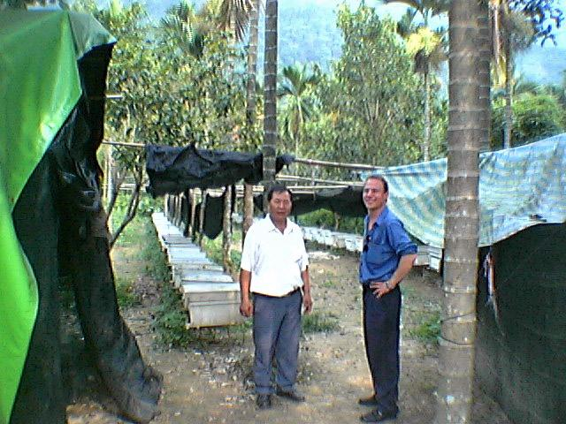
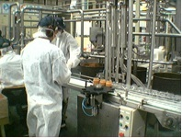
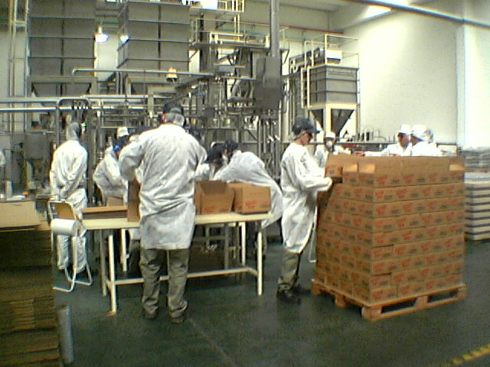
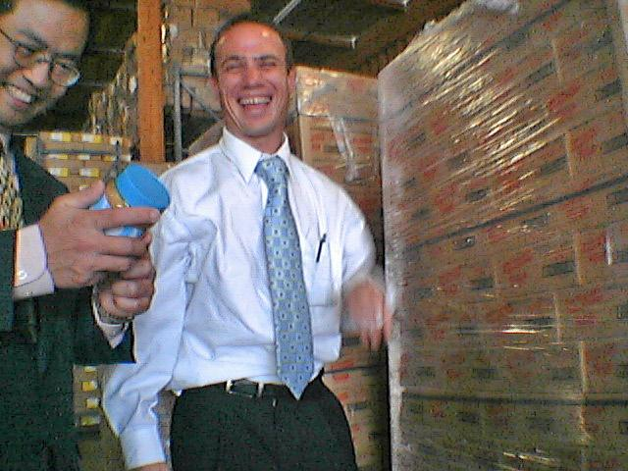
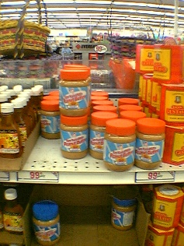
EXAMPLE 1 OF AN ADDED VALUE THAT WE WILL BE IMPLEMENTING HERE IN ITALY
Honey Production from Castor Flower
We use honey bees to ensure maximum pollination.
Each hectare can absorb 4-hives up to 10-hives, each hive producing on average 22 liters’ honey per month.
Castor Flower Honey is rare and unique, holding many medicinal healing properties.
Our Proprietary Castor strains flower all year round, hence we produce honey all year round.
Honey production will generate a healthy additional income and residual with each 1000 hectares Castor cultivation at full production generating at minimum over 1-million per year sold to the bottom end bulk close out Dollar Stores or Euro Stores, double in the food industry and as much as 5x in up market international stores or pharmacies.
We are currently in collaboration with Universities in Istanbul, Turkey & Bengal, India in relation to using Castor Oil & Ricin Extract, Castor Flower and Castor Honey & Propolis as an Anti-Cancer Remedy, currently exploring Castor’s medicinal properties and capabilities.

Slide 16
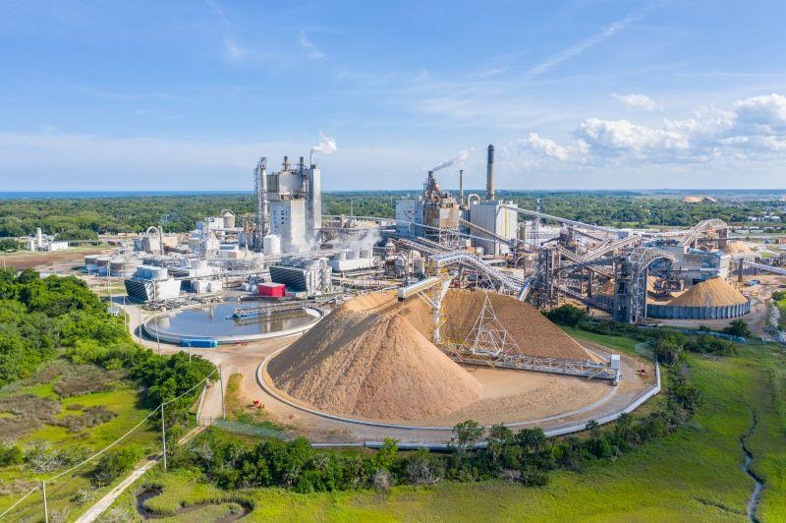
CULTIVATING 200,000 HECTARES OR MORE WOULD REQUIRE CONVERTING FROM MICRO FACTORIES (EACH PRODUCING MIMIMUM 67,584,000 LITERS PER YEAR), TO THE IMPLEMENTATION OF LARGE SCALE OIL REFINERIES PRODUCING HVO GREEN DIESEL THAT WOULD REQUIRE A GRAND TOTAL PRODUCTION CAPACITY OF MINIMUM 675,840,000 LITERS PER YEAR
(10 MICRO FACTORIES = 1 REFINERY).
STARTING AT AROUND 600,000,000 LITERS PER YEAR AND GROWING TO OVER 5-BILLION LITERS PER PRODUCTION AS SEEN HERE: Diamond Green Diesel | Renewable Fuel for a Low-Carbon World https://youtu.be/p3Mx6-rCpM8
IN 2013 DIAMOND GREEN DIESEL PRODUCED THEIR FIRST GALLON OF GREEN DIESEL, IN 10-YEARS THEY HAVE GROWN TO 1.2 BILLION GALLONS PER YEAR (OVER 4.5 BILLION LITERS RENEWABLE DIESEL) INVESTING IN OVER $1-BILLION USD EXPANSION.
Our Castor Oil Green Energy = GREEN OIL = RNEWAEBLES – Rainforest Reliance (rainforest-reliance.org)

Slide 17
SUMMARY
660 trees per hectare @q 4m spacing’s
1 tree = 800g seed per month
@44% Oil after pressing = 352g/ml oil
.352 x 660= 232.32 liters Castor Oil per Hectare Per Month.
X 12 months = 2,787.84 Liters Castor Oil Per Hectare, Per Year.
1,000 hectares = 2,787,840 liters Castor Oil Per Year (at 264 work days per year, requires 10,557 Liters Oil pressing Per Day)
Investing with us by cultivating and producing Castor Oil for use in up to and over 800 products and applications not only will fill a much needed demand in Italy. Our project also has the ability to service an ever increasing demand to the European Community by way of facilitating their requirements when it comes to the transition to renewables.
Castor Oil will be instrumental for the production of HVO (Hydro-Treated Vegetable Oil), a sustainable biofuel for use in the transport sector.
Europe are transforming their fossil fuel refineries over to Castor HVO, starting with the refinery in Sicily, Italy that currently produces Castor HVO Aviation Fuel for KLM Dutch Airlines (Schiphol Airport).
Europe rely heavily on the biomass industry and have over 1,000 Plants and Refineries that require what we produce, because we hold intellectual Propriety Castor Strains that far out-perform the market we are able to undercut by far any competition with both Castor Oil or any of its finished products and Bio-mass waste.
Bio-based industries are to replace non-renewable fossil resources with renewable bio-based products and materials from bio-mass and waste to produce industrial and consumer goods.
Renewables are the future and Castor Oil is an essential player in transitioning to renewables together with technology requirements and advances that depend on this valuable liquid gold.
Here you see and confirm in this video at the 2023 European Biomass Conference & Exhibition held in Bologna Italy, the role Castor Oil is going to play going forward here in Europe in the transition to renewables (in it you too get to see the ENI refinery in Sicily that has been converted to accommodate the conversion of Castor Oil to HVO) https://youtu.be/s3jhIXaVf-c BIKE workshop: "Upscaling the production of low-ILUC risk biomass" at the 31st EUBCE - BIKE Project (bike-biofuels.eu)
Join our children IIana & Abigail Wainer, together with their generation and pave the way to a greener, cleaner, sustainable future.

Slide 18
How to buy in?
Franchise Model
We offer a franchise plan similar to McDonald’s or any other franchise, where the franchisor licenses the use of intellectual property, trade mark and business model to the franchisee, in exchange for an upfront payment and royalty payments.
Like McDonald’s the franchisor holds 51% and the franchisee holds the remaining 49% (Franchisee includes investor and or agent @29%, cooperatives @10% and their farming members @10% profit share escrow fund).
Cooperative can also be the investor and retain 39% shareholding.
Just like McDonald’s we cater to a hungry market, “the energy market”, that without the world will stand still.
To qualify for a franchise one would need to have available and accessible a minimum of 1,000 to 1,500 Hectares land and a fund of 5,114,455.50 Euros to match.
We assist in the erection of your industrial city and build your business with you whilst we train you and you the franchisee retain an active role and financial independence.
We collectively share in the operations and rewards.
The franchisor is responsible for all production, sales and marketing, the cooperative and farmers ensure cultivation, the financier bridges the investment.
Financier to set-up fund in escrow, with attorney appointed in-charge of dispensing and procurements etc.
6 to 9-months needed to complete project from moment of signature and funding secured (dependent on factory land acquisition, zoning and building permits etc.)
Factory machinery can be ordered, produced, shipped and erected in 4 to 6-months from order-provided a facility and structure is ready to receive.
Cultivation is ready for first picking between month 4 & 5 onwards depending on Castor strain.
Production can begin as early as month 6 or 7 from signature.
Planting season begins end April through end October (minimum 16 degrees + is required for germination – average temperature in Puglia /Southern Italy is 16 to 17 degrees in April and 16 to21 degrees in October, with an average of 24 to 30-degrees during the summer months). Coldest months are December, January and February with temperatures reaching as low as 8 degrees.
Our proprietary castor trees can withstand temperatures as low as zero for short periods of time and only endure slight stress below 5 to 2-degrees.
Prolonged cold can cause stress and excessive water log for prolonged periods will cause root rot- good news is in Southern Italy and the Mediterranean the Olive land although barren and mostly rocky dry soils is well drained, normally on a slight slope, the hotter the temperature the better = more production.
Olive cultivations are generally grown between 10-degrees to maximum 50-degrees , with an average of 30-degrees = perfect for our Castor Trees ☺.

Slide 19
Please view our attached 5-year P & L.
Basically it shows for a relatively small investment of 5,114,455.50 we over a 5-year period derived an estimated revenue of between 32,000,000.00 and above, broken down as follows;
Castor Oil production converted to Bio-diesel over a 4-year period out of 5-years @ 4,000,000.00 per year = 16,000,000.00
Glycerin = byproduct from bio-diesel conversion production over a 4-year period out of 5-years @ an estimated minimum of 2,000,000.00 per
year = 8,000,000.00
Castor waste converted into bio-fertilizers or bio-methanol or bio-gas or a combination of all three @ minimum 1,000,000.00 over a 4-year out of
5-year period = 4,000,000.00
Honey production, 4-years out of 5-years @ minimum 1,000,000.00 = 4,000,000.00
TOTAL ESTIMATED REVENUE = 32,000,000.00 + in the first 5-years alone.
YES THAT IS CORRECT 640% ROI
Remember this is only the beginning, we have a long way to go in replacing one by one each and every fossil fuel derived product in the collective endeavor to replace with a bio-based circular economy.
Please join us on this new and exciting journey into the future, transitioning together for a better new sustainable world ☺.
Contact: jesse@rainforest-reliance.org , chantal@rainforest-reliance.org, Jeremy@rainforest-reliance.org
Italy # +39-350-9209021

